Slide 1
MCTE 3104 Mechatronics Interfacing Lab
Session no. 2: Intro to Raspberry Pi

Slide 2
Outline
Intro to Raspberry Pi
Hardware
OS
Raspberry Pi Pinouts
Digital I/O
Input / Output controls
PWM controls

Slide 3
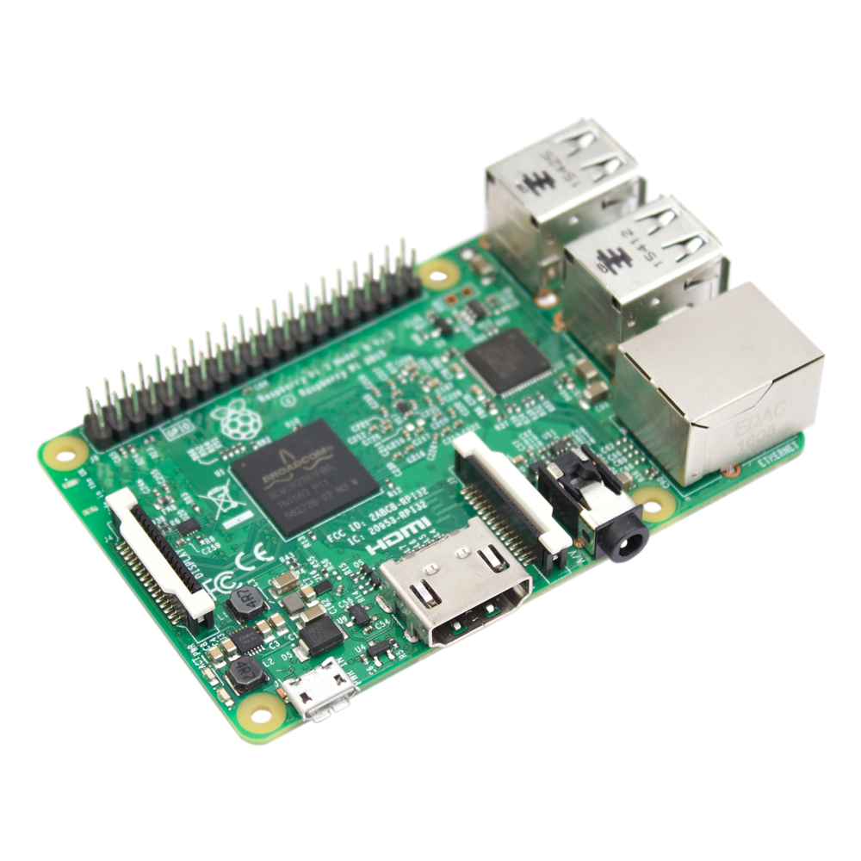
Technical specification of Raspberry Pi 3:
Broadcom BCM2837 64bit ARMv8 Quad Core Processor powered Single Board 1.2GHz
1GB RAM
WiFi on board
Bluetooth Low Energy (BLE) on board
40pin extended GPIO
4 x USB2 ports
Full size HDMI
CSI camera port for connecting the Raspberry Pi camera
DSI display port for connecting the Raspberry Pi touch screen display
MicroSD port for loading your operating system and storing data

Slide 4
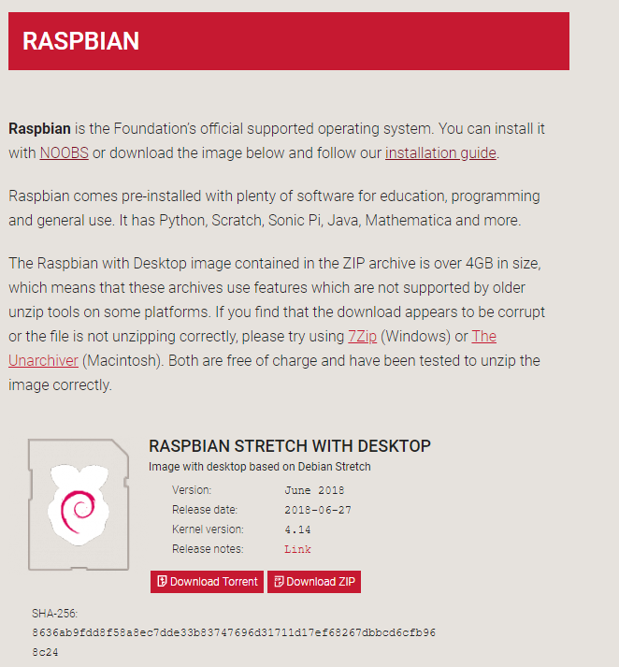
Raspberry PI OS
Raspberry PI Foundation provides a Raspberry PI official supported operating system called Raspbian where you can download from its official website.
Raspbian comes pre-installed with plenty of software for education, programming and general use. It has Python, Scratch, Sonic Pi, Java, Mathematica and more.
https://www.raspberrypi.org/downloads/raspbian/

Slide 5
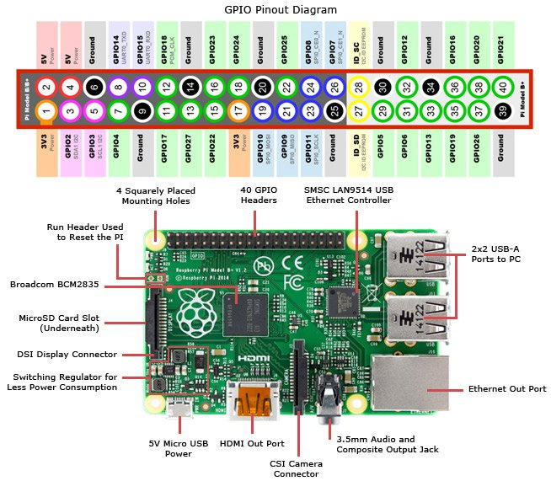

Slide 6
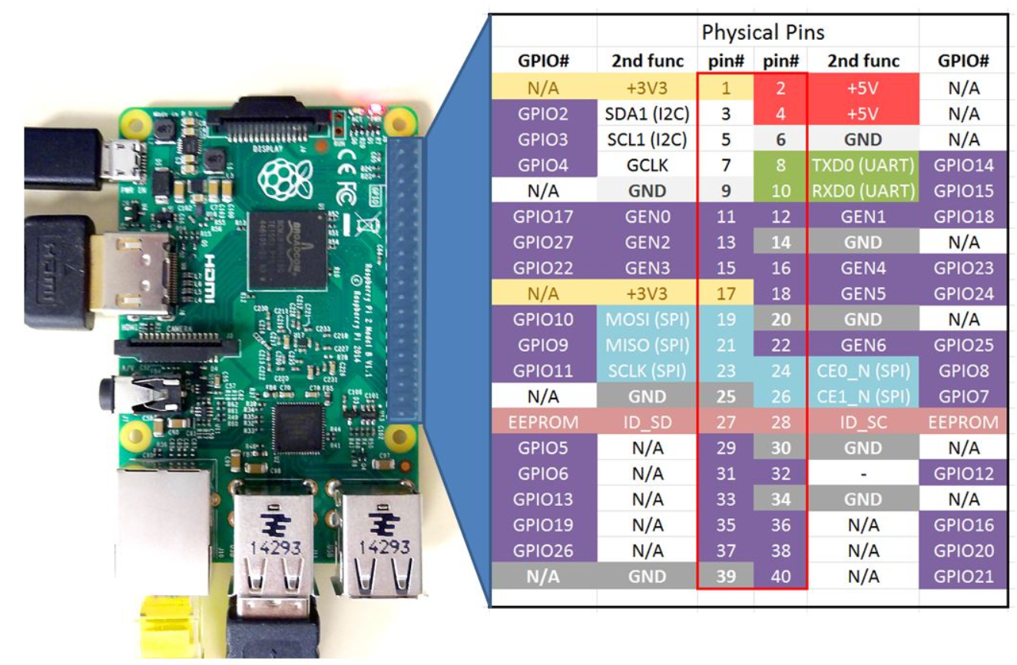
To begin using the Raspberry Pi GPIO, we first need to know Raspi's GPIO numbering system. The two inner columns (labelled pin#) in the chart shows the ‘physical pin number’ where as the outer two columns (labelled GPIO#) of the chart shows you the ‘BCM number’ (Broadcom numbering scheme).
Picture taken from
http://www.toptechboy.com/raspberry-pi/raspberry-pi-with-lesson-26-controlling-gpio-pins-in-python/

Slide 7
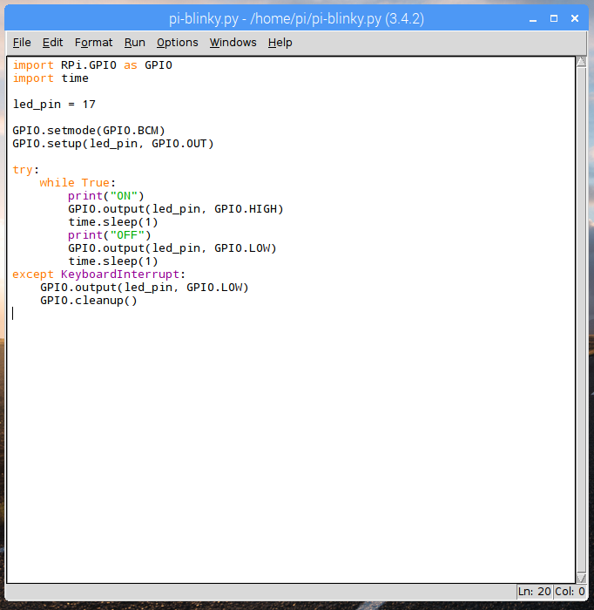
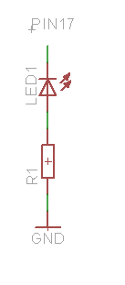
Simple GPIO control Raspberry Pi
Example 1: Writing digital output
If you want to use physical pin convention use
GPIO.setmode(GPIO.BOARD)

Slide 8
Simple GPIO control Raspberry Pi
Lab activity 1:
Connect 3 leds to the Raspi. Allow 1 led to blink every 0.5 second, 1 led that blinks every 1 second, and 1 that blinks every 3 seconds.

Slide 9
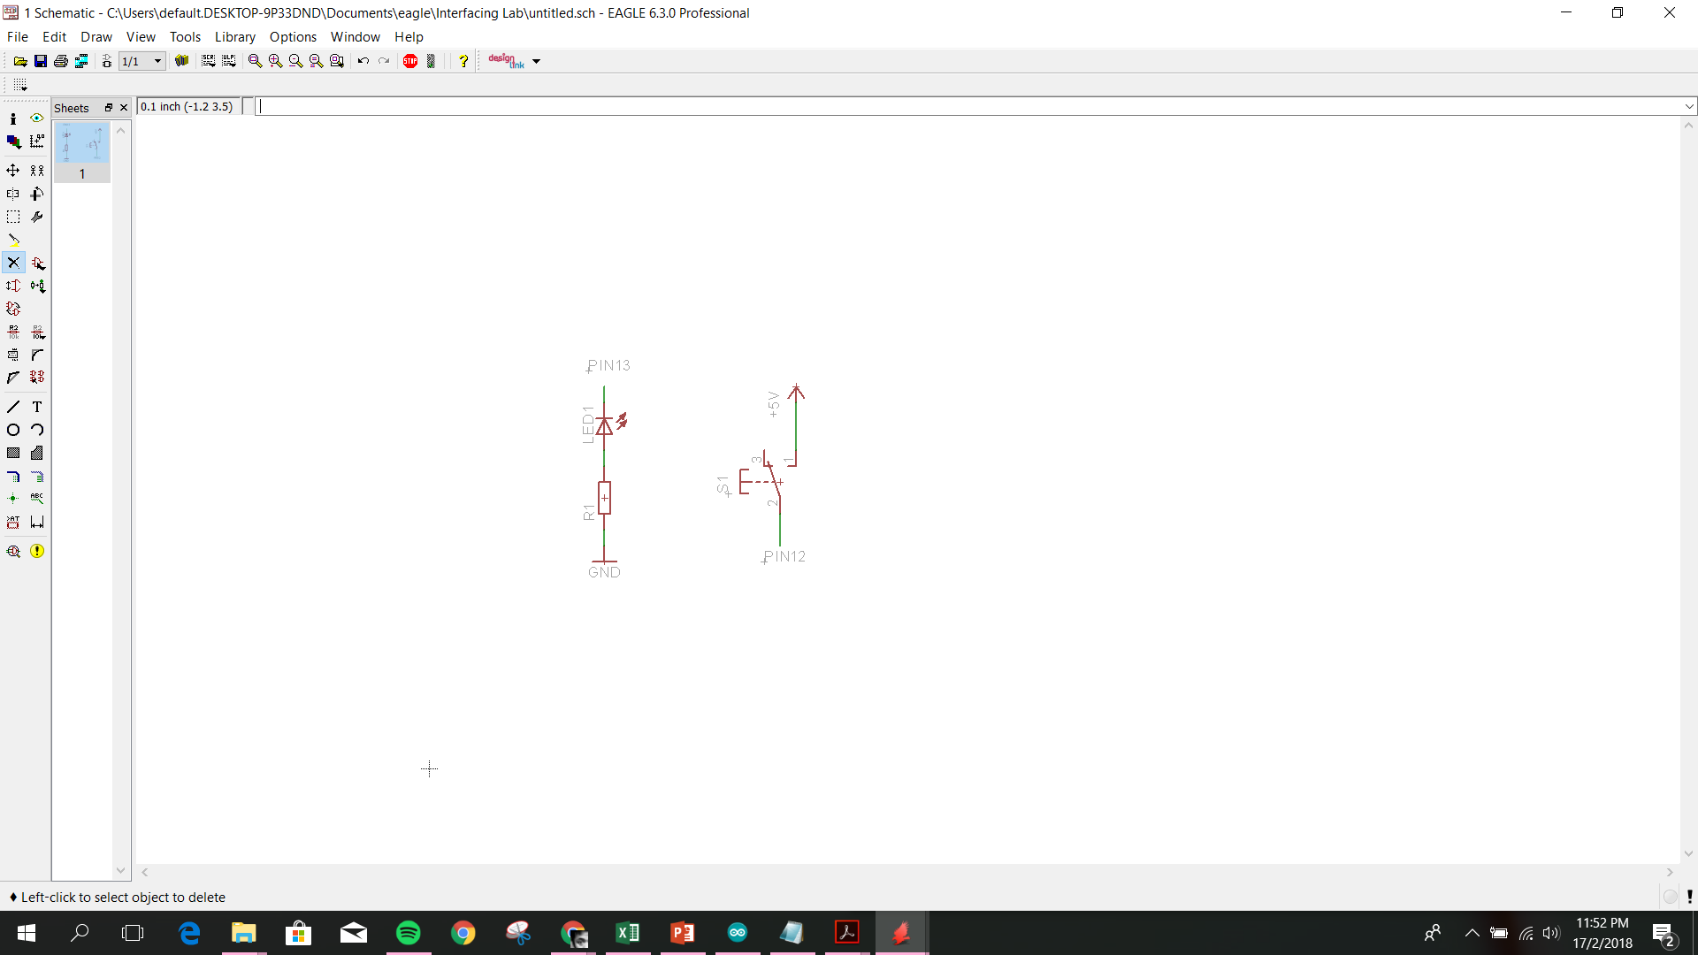
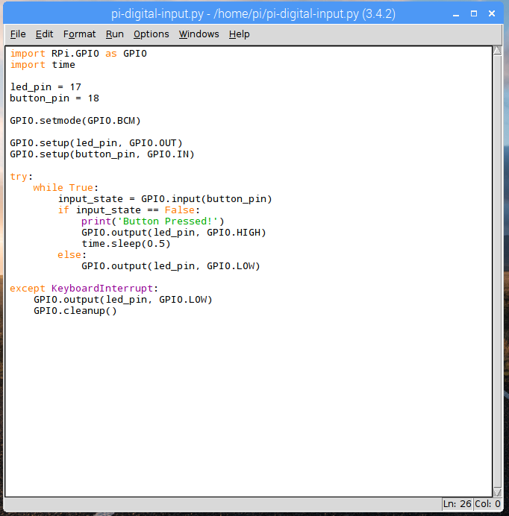
Simple GPIO control Raspberry Pi
Example 2: Reading digital input
PIN17
3V3+
R2
PIN18

Slide 10
Simple GPIO control Raspberry Pi
Lab activity 2:
Using the “Mini Strobe Siren” and linear actuator activate it with a push of a button.

Slide 11
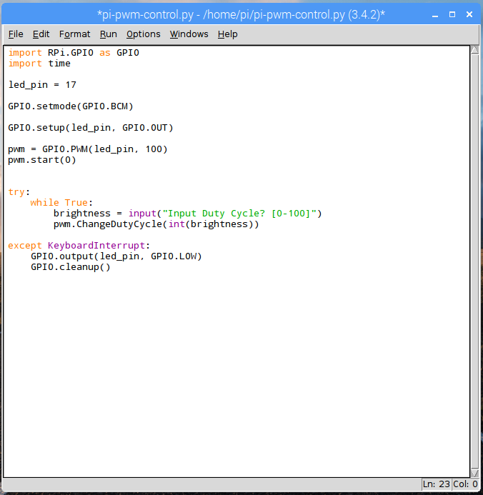
PWM control Raspberry Pi
Example 3: PWM output on Raspberry Pi

Slide 12
PWM control Raspberry Pi
Lab activity 3:
Connect 2 leds to the Raspberry Pi and create a different fading effect to individual leds.

